Slide 1

Introduction to Data Visualization Tools

Slide 2
Objectives
Describe the importance of data visualization
Relate the history of Matplotlib and its architecture
Apply Matplotlib to create plots using Jupyter notebooks
Data Visualization Tools

Slide 3
Introduction to Data Visualization
Why do you need visualize data ?
→ students give the opinions!
Data Visualization Tools

Slide 4
Introduction to Data Visualization
Why do you need visualize data ?
  A way to show complex data in a form that is graphical and easy to understand
  Very effective in conveying a clear description of the data
  Communicate data clearly
  Share unbiased representation of data
  Use the to support recommendations to different stakeholders
Data Visualization Tools

Slide 5
Introduction to Data Visualization
Key points when creating a visual:
  Less is more effective
  Less is more attractive
  Less is more impactive
→ Any feature or design you incorporate in your plot to make it more attractive
→ Support the message that the plot is meant to get across and not distract from it
Data Visualization Tools

Slide 6
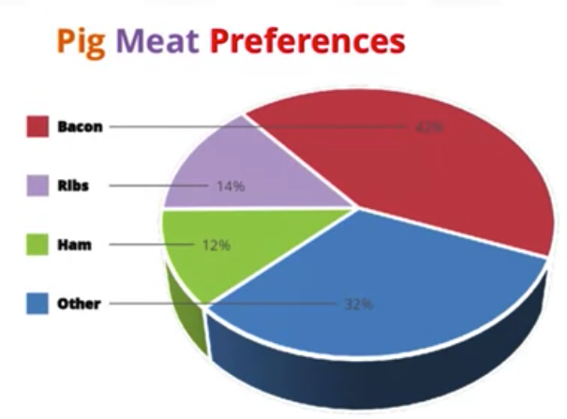
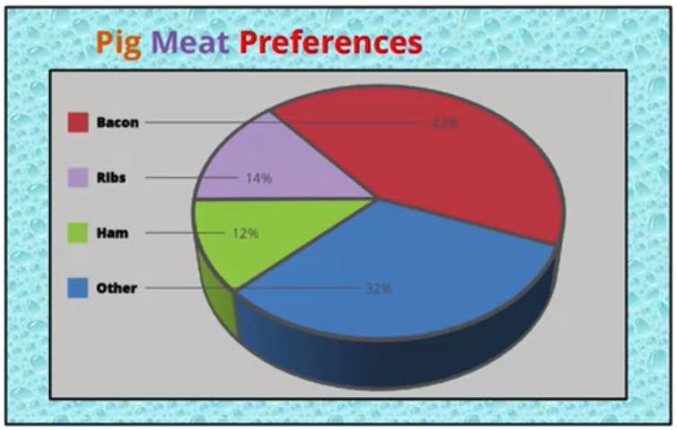
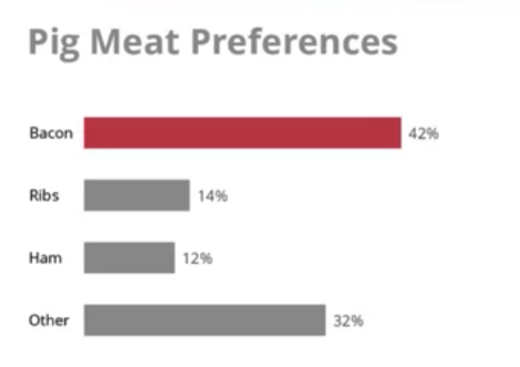
Introduction to Data Visualization
Example and discusses
Data Visualization Tools

Slide 7
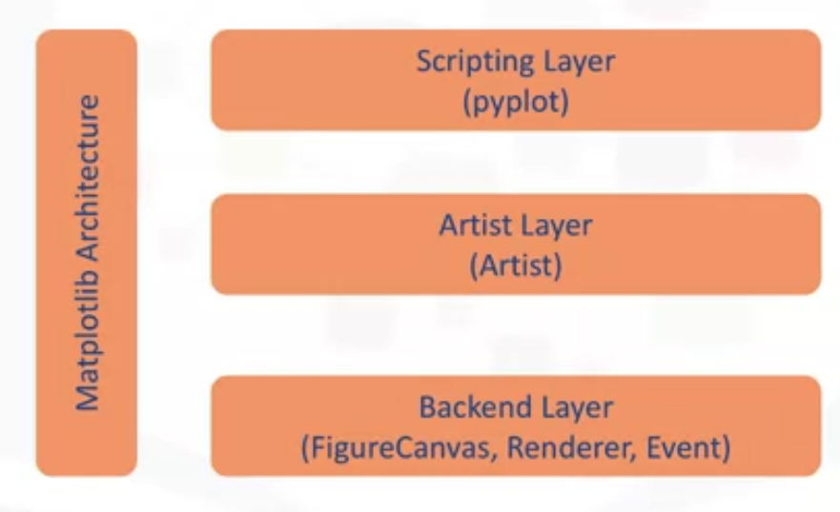
Introduction to Matplotlib
Data Visualization Tools

Slide 8
Introduction to Matplotlib
Matplotlib architecture
  The back-end layer
  The artist layer: the appropriate programming paradigm when writing a web application server, a UI application, or perhaps a script to be shared
  The scripting layer: the appropriate layer for the generation of graphics and plots.
Data Visualization Tools

Slide 9
Introduction to Matplotlib
Backend layer: three built-in abstract interface classes:
  FigureCanvas: defines and encompasses the area on which the figure is drawn.
  → matplotlib.backend_bases.FigureCanvas
  Renderer: an instance of the renderer class knows how to draw on the figure canvas.
  → matplotlib.backend_bases.Renderer
  Event: handles user inputs such as keyboard strokes and mouse clicks.
  → matplotlib.backend_bases.Event
Data Visualization Tools

Slide 10
Introduction to Matplotlib
Artist layer
  The artist is the object that knows how to take the Renderer and use it to put ink on the canvas.
  The title, the lines, the tick labels, the images, and so on, all correspond to an individual artist.
  There are two types of Artist objects.
    The primitive type: such as a line, a rectangle, a circle, or text.
    The composite type: such as the figure or the axes.
  Each composite artist may contain other composite artists as well as primitive artists.
Data Visualization Tools

Slide 11
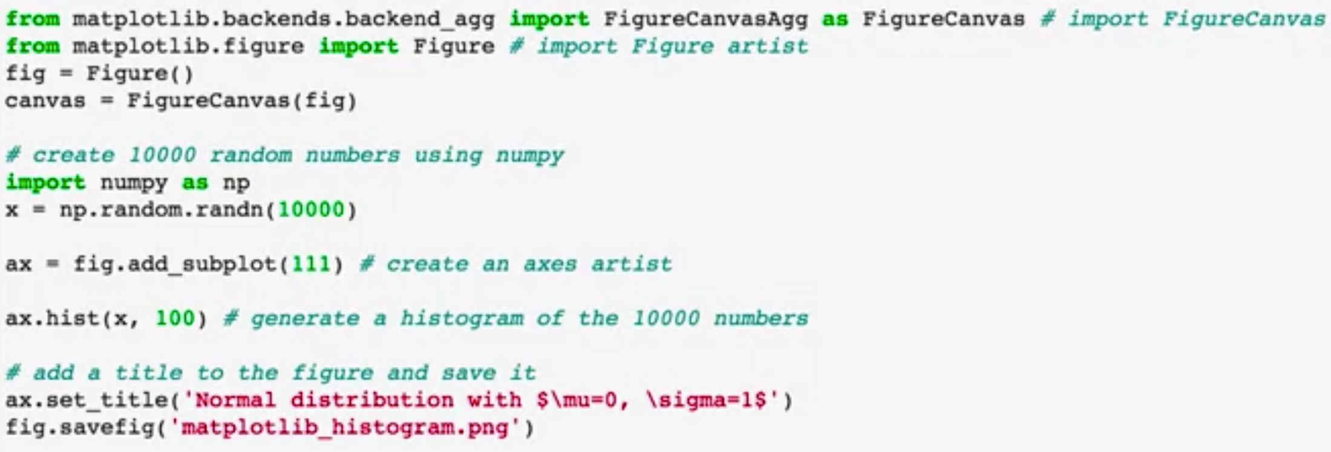
Introduction to Matplotlib
Check this code:
➔ Check this code and show your result!
Data Visualization Tools
Notes:
generate the histogram

Slide 12
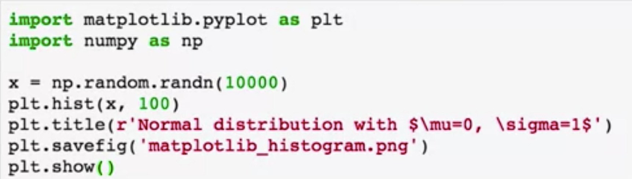
Introduction to Matplotlib
Scripting layer
  Matplotlib's scripting layer is essentially the Matplotlib.pyplot interface, which automates the process of defining a canvas and defining a figure artist instance and connecting them.
Try this code and show your results
Data Visualization Tools
Notes:
the same code that we used earlier using the artist layer to generate a histogram of 10,000 random numbers

Slide 13
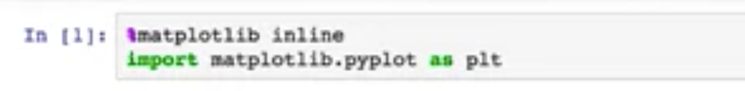
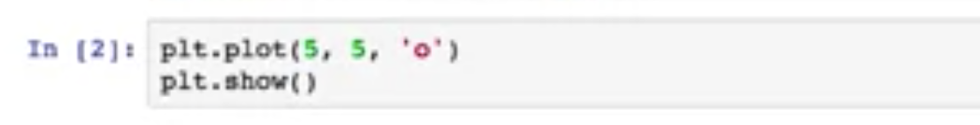
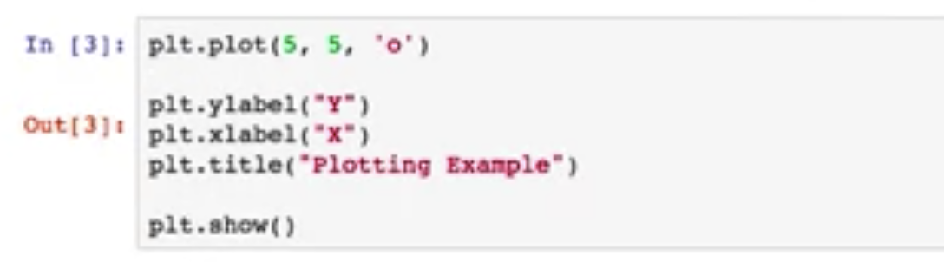
Basic Plotting with Matplotlib
Jupyter is an open-source web application that allows you to create and share documents that contain live code visualizations and some explanatory text
Try this code and show your results
Data Visualization Tools

Slide 14
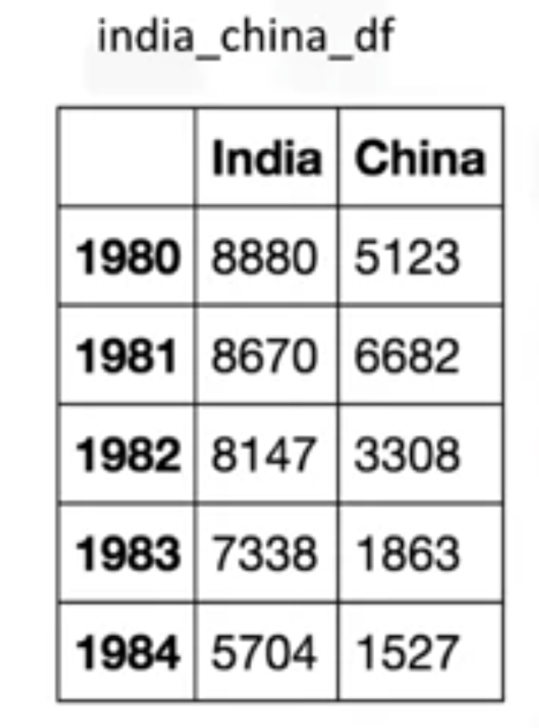

Basic Plotting with Matplotlib
We have a data frame of the number of immigrants from India and China to Canada from 1980 to 1996 ==>generating a line plot of these data.
Try the codes and show your results
Data Visualization Tools

Slide 15
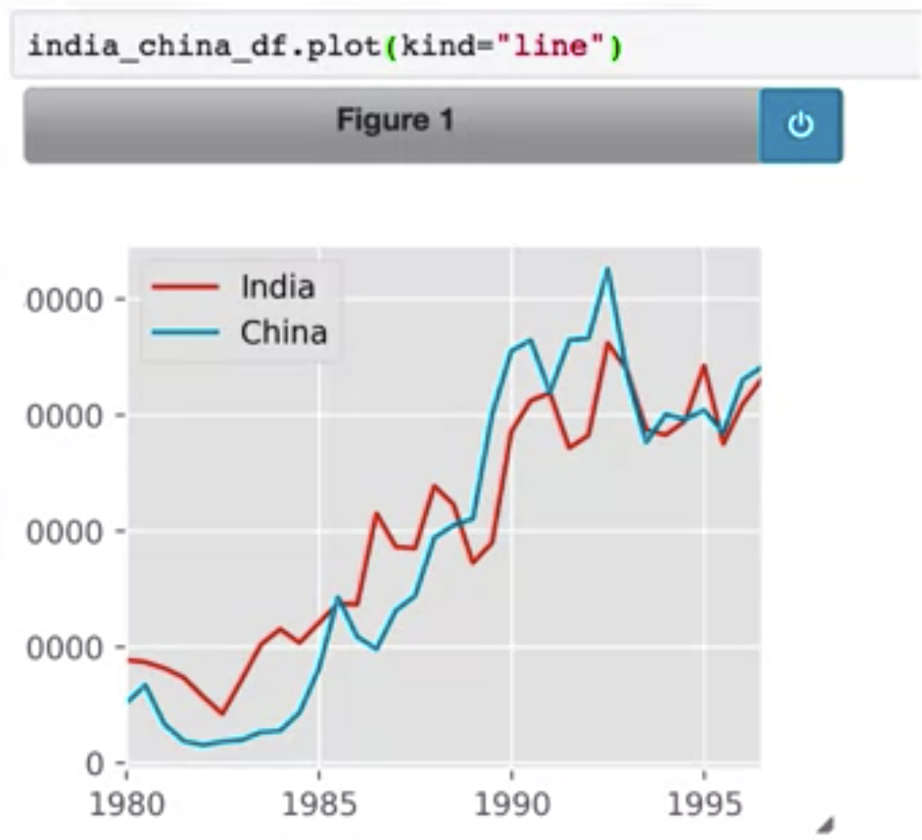
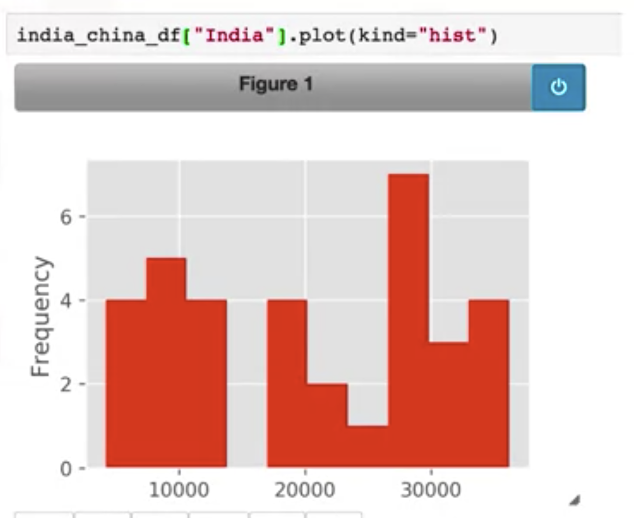
Basic Plotting with Matplotlib
Data Visualization Tools

Slide 16
Summary
Describe the importance of data visualization
Relate the history of Matplotlib and its architecture
Apply Matplotlib to create plots using Jupyter notebooks
Data Visualization Tools

Slide 17
Q & A
Data Visualization Tools

